Slide 1
ER Diagrams (Conceptual, Logical)
Team 2: UnitFit

Slide 2
Team 2: UnitFit
ER Diagram (Conceptual)
Customer ID
Phone number
Email
Workout Type
Customer ID
Workout Level
FName
Customer
choose
Workout Plan
LName
Password
use
Dashboard
Tracking weight
User ID
Tracking Calories
Calendar Tracking
Tracking Workouts
Tracking Time

Slide 3
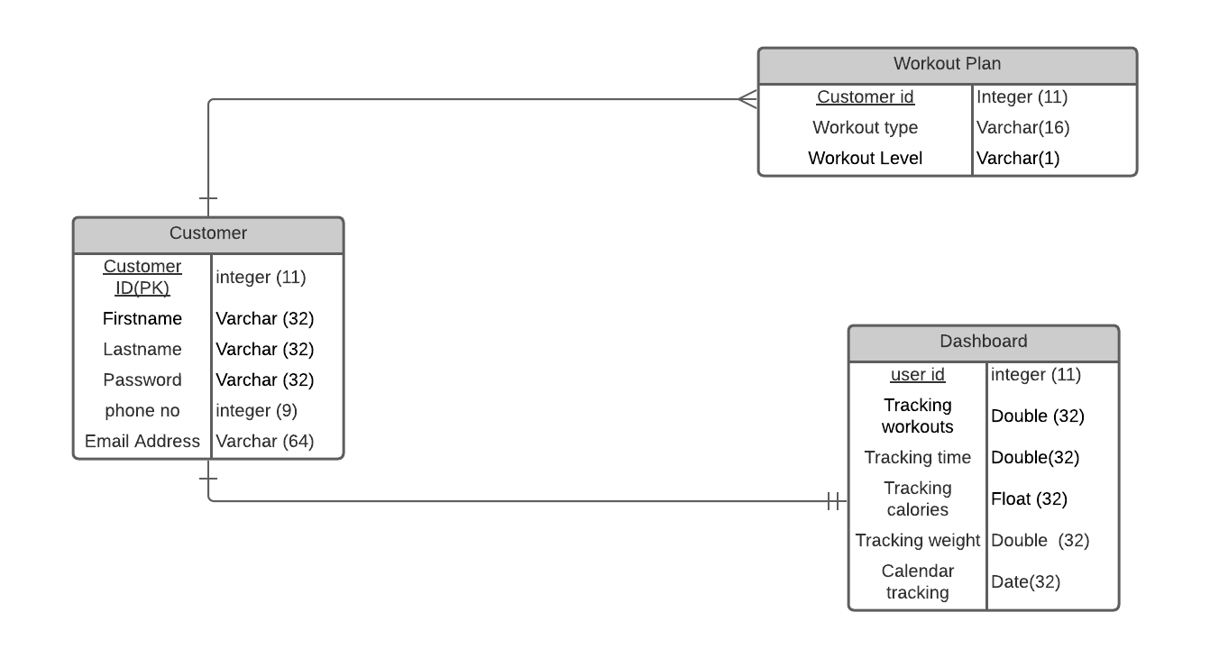
Logical ER diagram
ER Diagram (Logical)

